Slide 1
Chapter 3 Solving problems by searching

Slide 2
Objectives
Identify the type of agent that solve problem by searching
Problem formulation and goal formulation
Types of problem based on environment type
Discuss various techniques of search strategies

Slide 3
Type of agent that solve problem by searching
Such agent is not reflex or model based reflex agent because this agent needs to achieve some target (goal)
It can be goal based or utility based or learning agent
The basic algorithm for problem-solving agents consists of 3 phases:
Formulate the problem
Search for a solution and
Execute the solution.

Slide 4

In problem solving by searching, solution can be described into two ways. Solution can be provided as state sequence or action sequence
for example consider the vacuum cleaner world with initial state as shown bellow
Solution as state sequence becomes:
Solution as action sequence becomes
suck move Right suck

Slide 5
Example: Road map of Ethiopia
Aksum
100
200
Mekele
Gondar
180
80
Lalibela
110
250
150
Bahr dar
Dessie
170
Debre markos
330
Dire Dawa
230
330
400
Jima
Addis Ababa
100
430
Adama
370
Gambela
230
320
Nekemt
Awasa

Slide 6
Example: Road map of Ethiopia
Current position of the agent: Awasa.
Needs to arrive to: Gondar
Formulate goal:
be in Gondar
Formulate problem:
states: various cities
actions: drive between cities
Find solution:
sequence of cities, e.g., Awasa, Adama, Addis Ababa, Dessie, Godar

Slide 7
Generating action sequences- search trees
A search process can be viewed as building a search tree over the state space.
Search tree: is a tree structure defined by initial state and a successor function.
Search Node: is the root of the search tree representing initial state and without a parent.
A child node: is a node adjacent to the parent node obtained by applying an operator or rule.

Slide 8
Tree search example
Awasa
Adama
Addis Ababa
Gambela
Dire Dawa
Adama
Debre Markos
Awasa
Gambela
AA
Jima
Nekemt
Awasa
Dessie
BahrDar
AA
Lalibela
AA
Gondar
Gondar
Debre M.

Slide 9
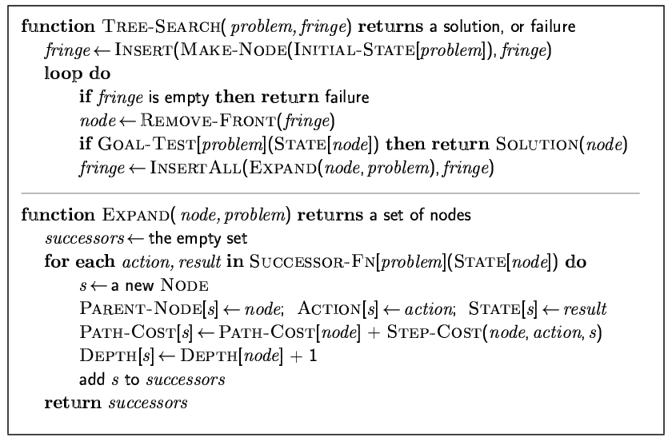
Implementation: general tree search

Slide 10
Search strategies
A search strategy is defined by picking the order of node expansion
Strategies are evaluated along the following dimensions:
completeness: does it always find a solution if one exists?
time complexity: number of nodes generated
space complexity: maximum number of nodes in memory
optimality: does it always find a least-cost solution?
Time and space complexity are measured in terms of
b: maximum branching factor of the search tree
d: depth of the least-cost solution
m: maximum depth of the state space (may be ∞)
Generally, searching strategies can be classified in to two as uninformed and informed search strategies

Slide 11
Uninformed search (blind search) strategies
Uninformed search strategies use only the information available in the problem definition.
They have no information about the number of steps or the path cost from the current state to the goal.
They can distinguish the goal state from other states
They are still important because there are problems with no additional information.
Six kinds of such search strategies will be discussed and each depends on the order of expansion of successor nodes.
Breadth-first search
Uniform-cost search
Depth-first search
Depth-limited search
Iterative deepening search
Bidirectional search

Slide 12
Generating action sequences- search trees
Leaf Node: is a node without successors ( or children).
Depth (d): of a node is the number of actions required to reach it from the initial state.
Frontier or Fringe Nodes: are the collection of nodes that are waiting to be expanded.
Path cost: of a node is the total cost leading to this node.
Branch Factor(b): Max. number of successors for any node.

Slide 13
Breadth-first search
Is one simple search strategy
Uses no prior information, nor knowledge
It tracks all nodes because it does not know whether this node leads to a goal or not!
Keep on trying until you get solution
We are searching but with cost

Slide 14
Breadth-first search
In this strategy
All nodes are expanded from the root node
That is, the root node is expanded first
Then, all the nodes generated by the root node are expanded next
Then, their successors, and so on
That is, BFS expands all nodes at level d before expanding nodes at level d+1
It checks all paths of a given length before moving to any longer path
Expands the shallowest node first

Slide 15
Breadth-First Search
The figure shows the progress of the search on a simply binary tree BFS trees after 0, 1, 2, 3, and 4 nodes expansion

Slide 16
Breadth-First Search- Example
S
A
D
Move downwards, level by level, until goal is reached.
B
D
A
E
C
E
E
B
B
F
D
F
B
F
C
E
A
C
G
G
C
G
F
G

Slide 17
Breadth-First Search algorithm
Blind search in which the list of nodes is a queue
To solve a problem using breadth-first search:
1.Set L to be a list of the initial node in the problem.
2.If L is empty, return failure otherwise pick the first node n from L
3.If n is a goal state, quit and return the path from initial node to n
4.Otherwise remove n from L and add to the end of L all of n's children. Label each child with its path from initial node
5.Return to 2.

Slide 18
Algorithm for Breadth-first search
BFS can be implemented using a queuing function that puts the newly generated states at the end of the the que, after all previously generated states
1. QUEUE <-- path only containing the root;
2. WHILE QUEUE is not empty
AND goal is not reached
DO remove the first path from the QUEUE;
create new paths (to all children);
reject the new paths with loops;
add the new paths to back of QUEUE;
3. IF goal reached
THEN success;
ELSE failure;

Slide 19
Properties of breadth-first search
Complete? Yes (if b is finite, which is true in most cases)
Time? 1+b+b²+b³+… +b^{d} = O(b^{d+1})
at depth value = i , there are b^{i} nodes expanded for i ≤d
Space? O(b^{d}) (keeps every node in memory)
a maximum of this much node will be while reaching to the goal node
This is a major problem for real problem
Optimal? Yes (if cost = constant (k) per step)
Space is the bigger problem (more than time)

Slide 20
Using the same hypothetical state space find the time and memory required for a BFS with branching factor b=10 and various values of the solution depth d

Slide 21
Depth-first Search (DFS)
Pick one of the children at every node visited, and work forward from that child.
Always expands the deepest node reached so far (and therefore searches one path to a leaf before allowing up any other path).
Thus, it finds the left most solution

Slide 22
Depth-first search- Chronological backtracking
Select a child
convention: left-to-right
Repeatedly go to next child, as long as possible.
Return to left-over alternatives (higher-up) only when needed.
S
A
B
D
C
E
D
F
G

Slide 23
Depth-first search algorithm
1. QUEUE <-- path only containing the root;
2. WHILE QUEUE is not empty
AND goal is not reached
DO remove the first path from the QUEUE;
create new paths (to all children);
reject the new paths with loops;
add the new paths to front of QUEUE;
3. IF goal reached
THEN success;
ELSE failure;

Slide 24
Time Requirements of Depth-First Search
Then the worst case time complexity is O(b^{m})
However, for very deep (or infinite due to cycles) trees this search may spend a lot of time (forever) searching down the wrong branch
It is also more likely to return a solution path that is longer than the optimal
Because it may not find a solution if one exists, this search strategy is not complete.
Remarks: Avoid DFS for large or infinite maximum depths.

Slide 25
DFS Practical evaluation:
DFS is a method of choice when there is a known (and reasonable) depth bound, and finding any solution is sufficient.
1.Depth-first search:
IF the search space contains very deep branches without solution, THEN Depth-first may waste much time in them.
2. Breadth-first search:
Is VERY demanding on memory !
Solutions ??
Iterative deepening

Slide 26
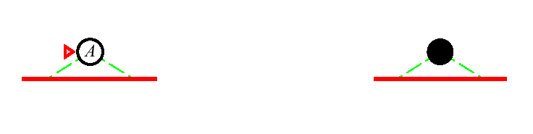

Iterative Deepening Search Algorithm
The order of expansion of states is similar to BFS,except that some states are expanded multiple times
Iterative Deepening Search l = 0
Limit = 0
Iterative Deepening Search l = 1

Slide 27
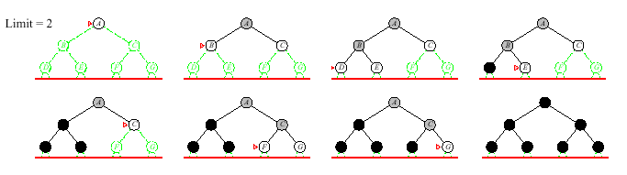
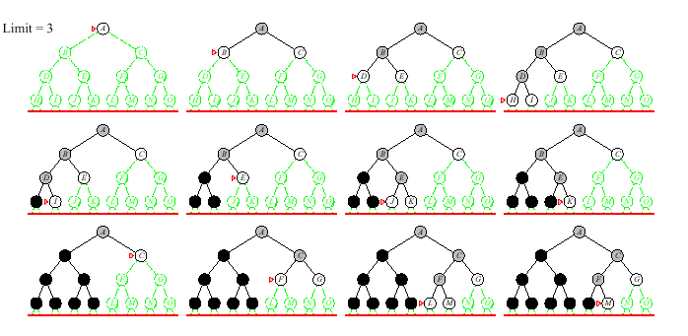
Iterative Deepening Search l = 2
Limit = 2
Iterative Deepening Search l = 3
Limit = 3

Slide 28
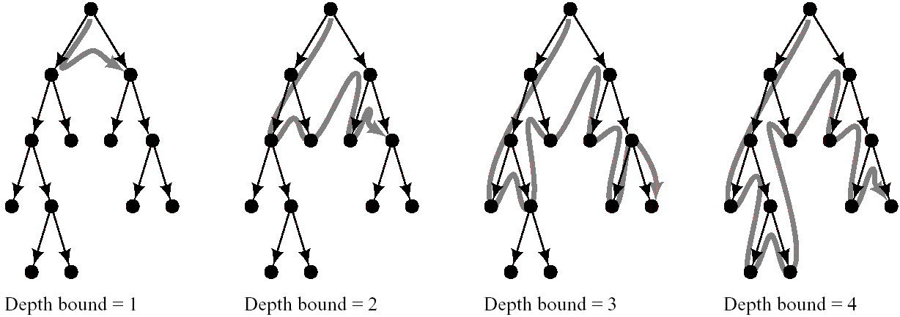
Iterative Deepening Search l = 1 to l=4
Stages in Iterative-Deepening Search
It requires little memory (a constant times depth of the current node)
Is complete
Finds a minim-depth solution as does BFS

Slide 29
Iterative Deepening Search Algorithm
1. DEPTH <-- 1
2. WHILE goal is not reached
DO perform Depth-limited search;
increase DEPTH by 1;
It is a strategy that avoids (sidesteps) the issue of choosing the best depth limit by trying all possible depth limits
Finds the best depth limit by gradually increase the limit -> 0, 1, 2, …until goal is found at depth limit d

Slide 30
Completeness and optimality of Iterative Deepening Search
Completeness
It is complete
It finds a solution if exists
Optimality
It is optimal
Finds the shortest path (like breadth first)
Guarantee shortest path
Guarantee for goal node of minimal depth

Slide 31
Uniform-cost search
Uniform-cost search is a searching algorithm used for traversing a weighted tree or graph.
The primary goal of the uniform-cost search is to find a path to the goal node which has the lowest cumulative cost.
Uniform-cost search expands nodes according to their path costs form the root node.
A uniform-cost search algorithm is implemented by the priority queue. It gives maximum priority to the lowest cumulative cost.
Uniform cost search is equivalent to BFS algorithm if the path cost of all edges is the same.

Slide 32
Implementation:
fringe = queue ordered by path cost

Slide 33
Bidirectional search
Bidirectional search algorithm runs two simultaneous searches, one form initial state called as forward-search and other from goal node called as backward-search, to find the goal node.
The search stops when these two graphs intersect each other.
Bidirectional search can use search techniques such as BFS, DFS, DLS, etc.
Advantages:
Bidirectional search is fast.
Bidirectional search requires less memory
Disadvantages:
Implementation of the bidirectional search tree is difficult.

Slide 35
S
Forward
A
D
Backwards
B
D
A
E
C
E
E
B
B
F
11
D
F
B
F
C
E
A
C
G
14
17
15
15
13
G
C
G
F
19
19
17
G
25

Slide 36
Search
Bi-directional Search
Completeness: yes
Optimality: yes
Time complexity: O(b^{d/2})
Space complexity: O(b^{d/2})
Initial State
Final State
d / 2
d
O(b^{d}) vs. O(b^{d/2}) ? with b=10 and d=6 results in 1,111,111 vs. 2,222.

Slide 37
Informed search
Informed search algorithms
Best-first search
Memory Bound Best First search
Iterative improvement algorithm (Local search algorithms)
Use an evaluation function f(n)
Admissible heuristics

Slide 38
Informed search algorithms
Informed search is a strategy that uses information about the cost that may incur to achieve the goal state from the current state.
The information may not be accurate. But it will help the agent to make better decision
This information is called heuristic information
There several algorithms that belongs to this group. Some of these are:
Best-first search
Greedy best-first search
A* search
Memory Bound Best First search
Iterative deepening A* (IDA*) search
Iterative improvement algorithm (Local search algorithms)
Hill-climbing search
Simulated annealing search

Slide 39
Best-first search
Idea: use an evaluation function f(n) for each node
Estimate of "desirability“ using heuristic and path cost
Expand most desirable unexpanded node
The information gives a clue about which node to be expanded first
The best node according to the evaluation function may not be best
Implementation:
Order the nodes in fringe in decreasing order of desirability (increasing order of cost evaluation function)

Slide 40
Best-First Search
Put the initial node on a list START
If (START is empty) or (START =GOAL) terminate search
Remove the first node form START. Call this node n.
If (n = GOAL) terminate search with success.
Else if node n has successor, generate all of them. Find out how far the goal node. Sort all the children generated so far by the remaining distance from the goal.Name this list as START1
Replace START with START1
Goto Step2.

Slide 41
Greedy Search
f(n)= h(n)
# of nodes tested 1, expanded 1
S
h=8
1
8
Expanded Node | OPEN list
 | (S:8)
S not goal | (C:3,B:4,A:8)
5
A
h=8
B
h=4
C
h=3
9
4
3
7
5
D
h=
G
h=0
E
h=

Slide 42
Greedy Search
f(n)= h(n)
# of nodes tested 2, expanded 2
S
h=8
Expanded Node | OPEN list
 | (S:8)
S | (C:3,B:4,A:8)
C not goal | (G:0,B:4,A:8)
1
8
5
A
h=8
B
h=4
C
h=3
9
4
3
7
5
D
h=
G
h=0
E
h=

Slide 43
Greedy Search
f(n)= h(n)
# of nodes tested 3, expanded 2
S
h=8
Expanded Node | OPEN list
 | (S:8)
S | (C:3,B:4,A:8)
C | (G:0,B:4,A:8)
G goal | (B:4.A:8) no expand
1
8
5
A
h=8
B
h=4
C
h=3
9
4
3
7
5
D
h=
G
h=0
E
h=

Slide 44
Greedy Search
f(n)= h(n)
# of nodes tested 3, expanded 2
S
h=8
Expanded Node | OPEN list
 | (S:8)
S | (C:3,B:4,A:8)
C | (G:0,B:4,A:8)
G goal | (B:4.A:8)
1
8
5
A
h=8
B
h=4
C
h=3
9
4
3
7
5
D
h=
G
h=0
* Fast but not optimal
E
h=
Path: S,C,G
Cost: 13

Slide 45
Greedy best-first search
Evaluation function f(n) = h(n) (heuristic) = estimate of cost from n to goal
That means the agent prefers to choose the action which is assumed to be best after every action.
e.g., h_{SLD}(n) = straight-line distance from n to Bucharest
Greedy best-first search expands the node that appears to be closest to goal (It tries to minimizes the estimated cost to reach the goal)
Example One Greedy best-first search example
Show the flow to move from Awasa to Gondar using the given road map graph

Slide 46
Ethiopia Map with step costs in km
Straight Line distance to Gondar
Aksum
Gondar 0
Aksum 100
Mekele 150
Lalibela 110
Desseie 210
Bahrdar 90
Debre Markos 170
Addis Ababa 321
Jima 300
Diredawa 350
Adama 340
Gambela 410
Awasa 500
Nekemt 420
100
200
Mekele
Gondar
180
80
Lalibela
110
250
150
Bahr dar
Dessie
170
Debre markos
330
Dire Dawa
230
330
400
Jima
Addis Ababa
100
430
Adama
370
Gambela
230
320
Nekemt
Awasa

Slide 47
Example Two:- Greedy best-first search example
Given the following tree structure, show the content of the open list and closed list generated by Greedy best first search algorithm.
Heuristic
R → G -------------- 100
A → G -------------- 60
B → G -------------- 80
C → G -------------- 70
D → G -------------- 65
E → G -------------- 40
F → G -------------- 45
H → G ---------------10
I → G ---------------- 20
J → G ---------------- 8
G₁,G₂,G₃ → G ------------ 0
R
A
B
C
D
E
F
G1
H
G2
I
G3
J

Slide 48
Properties of greedy best-first search
Complete? Yes if repetition is controlled otherwise it can can get stuck in loops
Time? O(b^{m}), but a good heuristic can give dramatic improvement
Space? O(b^{m}), keeps all nodes in memory
Optimal? No

Slide 49
A* search
Idea: Avoid expanding paths that are already expensive
Evaluation function f(n) = g(n) + h(n) where
g(n) = cost so far to reach n
h(n) = estimated cost from n to goal
f(n) = estimated total cost of path through n to goal
It tries to minimizes the total path cost to reach into the goal at every node N.
Example two
by using map of Ethiopia in previous slid , Indicate the flow of search to move from Awasa to Gondar using A*

Slide 50
Example Two
Given the following tree structure, show the content of the open list and closed list generated by A* best first search algorithm.
Heuristic
R → G -------------- 100
A → G -------------- 60
B → G -------------- 80
C → G -------------- 70
D → G -------------- 65
E → G -------------- 40
F → G -------------- 45
H → G ---------------10
I → G ---------------- 20
J → G ---------------- 8
G₁,G₂,G₃ → G ------------ 0
R
35
70
40
A
B
C
25
10
18
62
21
45
D
E
F
G1
H
G2
15
20
5
I
G3
J

Slide 51
Admissible heuristics
A heuristic h(n) is admissible if for every node n,
h(n) ≤ h*(n), where h*(n) is the true cost to reach the goal state from n.
An admissible heuristic never overestimates the cost to reach the goal, i.e., it is optimistic
Example: h_{SLD}(n) (never overestimates the actual road distance)
Theorem:
If h(n) is admissible, A* using TREE-SEARCH is optimal

Slide 52
Example
n | g(n) | h(n) | f(n) | h*(n)
S | 0 | 8 | 8 | 9
A | 1 | 8 | 9 | 9
B | 5 | 4 | 9 | 4
C | 8 | 3 | 11 | 5
D | 4 | ◎ | ◎ | ◎
E | 8 | ◎ | ◎ | ◎
G | 10/9/13 | 0 | 10/9/13 | 0
S
h=8
1
8
5
A
h=8
B
h=4
C
h=3
9
4
3
7
5
D
h=
G
h=0
E
h=
Since h(n)  h*(n)  n, h is admissible.

Slide 53
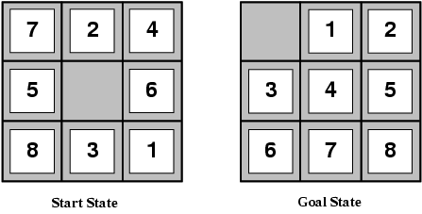
Find Admissible heuristics for the 8-puzzle?
h₁(n) = number of misplaced tiles
h₂(n) = total Manhattan distance (i.e., no. of squares from desired location of each tile). This is also called city cap distance
h₁(S) = ?
h₂(S) = ?

Slide 54
Iterative Improvement Algorithm (Local search algorithms)
Iterative best improvement is a local search algorithm that selects a successor of the current assignment that most improves some evaluation function.
If there are several possible successors that most improve the evaluation function, one is chosen at random.
When the aim is to minimize, this algorithm is called greedy descent.
When the aim is to maximize a function, this is called hill climbing or greedy ascent. We only consider minimization; to maximize a quantity, you can minimize its negation

Slide 55
Iterative Improvement Algorithm (Local search algorithms)
There are two types of Iterative Improvement algorithms
Hill climbing if the evaluation function is quality
also called Gradient Descent if the evaluation function is a cost rather than a quality
Simulated Annealing
Hill-climbing search
Tries to make changes that improve the current state cost
It continually move in the direction of increasing value
The node data structure maintain only records of state and evaluation cost

Slide 56
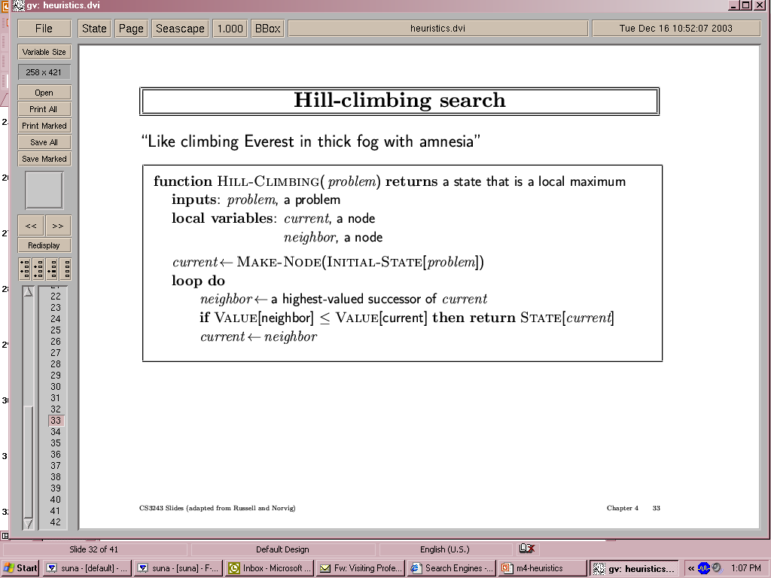
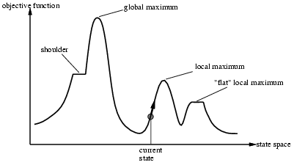
Hill-climbing (Gradient Descent) search
Tries to make changes that improve the current state cost
Problem:
Depending on initial state, can get stuck in local maxima
Plateaux (after some progress the algorithm will make a random walk)
Ridges (a place where two sloppy sides meet). In this case the search may oscillate from side to side

Slide 57
Exercise 1
Consider the search space with start S and goal G states. The value of heuristics h are shown at each node. The cost associated with the each arc is not known. However, the trace of the OPEN list produced by the execution of A* algorithm is available(given below) along with the f values.
Determine the arc cost of arcs.
{ (S, f=1)}
{(B, f=5), (A, f=6)}
{(A, f=6), (C, f=7)}
{(C, f=6)}
{(D, f=5), (G, f=7)}
{(G,f=6)}
S
h=1
h=3
A
B
h=5
C
h=2
D
G
h=0
h=0

Slide 58
Exercise 2. list out all nodes to reach the goal with Greedy best and A* search and which one is optimal
S
A
1
A
S
B
3
2
10
S
C
5
2
S
G
9
5
A
B
1
5
S
B
G
A
C
3
A
G
3
10
2
B
C
2
B
G
4
5
C
G
4
C

Slide 59
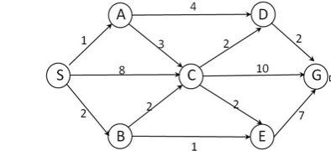
Exercises

Slide 60
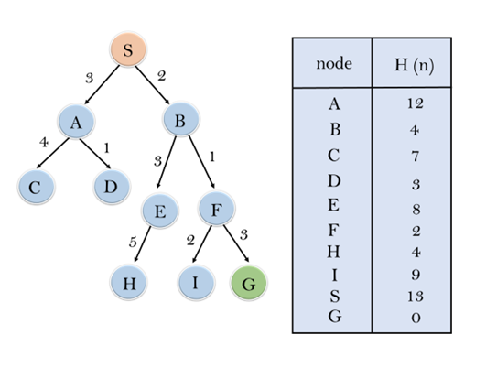
Exercises

Slide 61
Thanks!!!

